Slide 1
Lecture 14 October 4,2019
Awesome job in lab! See Excel spreadsheet and hardcopy pdf of data on the website.
Go over lab 3-4 guidelines
Return lab report 2 and pop quiz
Schwandt family fun!

Slide 2
Where were we?....
Chi Square analysis
Null hypothesis
P-values
Sample size

Slide 3
New Stuff…. How might we look at transmission of traits in humans?...
P1 F1 F2?
NO! We cannot control breeding in humans!
We are rarely “true breeding” as we choose our mates from outside our clan
F1 X F1---not culturally acceptable
F2—do not produce hundreds of offspring

Slide 4
Can do a “retrospective” examination of family called---Pedigree
Allows us to look at how a trait was passed from parents to offspring through 2 or more generations.
Can trace specific traits, diseases, etc. and ask…
Are these traits passed in a 1 gene-1 trait (Mendelian) pattern?
Can we see that a trait looks dominant or recessive?
Can we predict probabilities of the trait showing up in future generations?

Slide 5
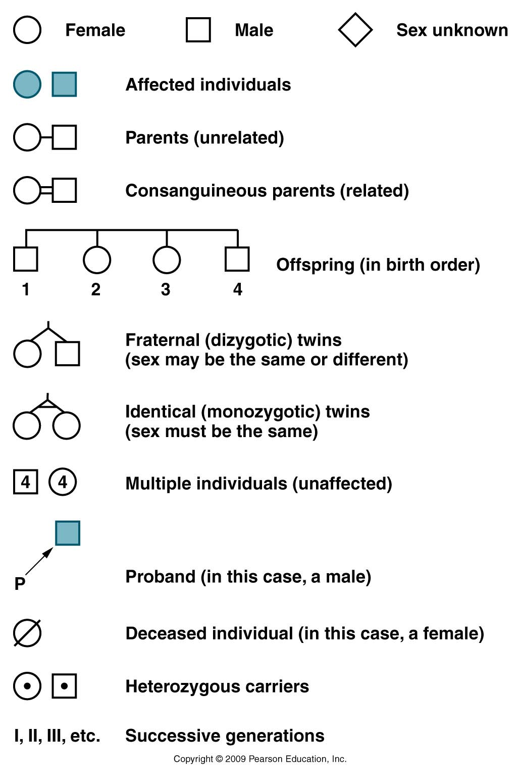
Pedigree conventions (ways of doing things)
(people who show the trait we
are following)
(the person whose condition initiated the study of the family)
P=“proband”
Usually not shown—can be inferred
Figure 3.13
Notes:
Figure 3-13 Conventions commonly encountered in human pedigrees.

Slide 6
Analysis of pedigrees usually answers 2 questions…
Based on the pattern, what is the most likely mode of inheritance of this trait?
recessive trait
dominant trait
seems not to follow Mendelian patterns
Not a genetic trait at all
Shows an extension of Medelian inheritance

Slide 7
2. If the trait shows a genetic pattern, what are the most likely genotypes for the individuals?

Slide 8
Some general pointers for pedigree analysis…
Practice! Draw out possibilities and see if they make sense! Assign a mode of inheritance. Do all individuals fit within this mode?
Remember, these are not Mendel’s crosses—parents are not necessarily “true-breeding”
Predict probabilities for outcomes.
Remember some alleles can be considered rare or common in the population.
Life is not a Punnett square.

Slide 9
Practice!
Does the affected individual appear to have a dominant or a recessive trait? (assuming the trait is genetic).

Slide 10
Practice!
My guess---This shows the characteristics of a recessive trait.
If true, the parents are heterozygotes who don’t show the trait.
The affected child is homozygous recessive.
The unaffected children are heterozygotes or homozygous dominant

Slide 11
Try applying genotypes---If anything is impossible, your guess is wrong!
Aa
Aa
Shows the characteristics of a recessive trait.
If true, the parents are heterozygotes.
The affected child is homozygous recessive.
The unaffected children are heterozygotes or homozygous dominant
A__
A__
aa
A__
It’s extremely important to realize in real life, in families,
traits do not have to show theoretical frequencies (even though this example
does show a 25% frequency) RECALL THE SCHWANDT FAMILY!!

Slide 12
What if we had decided it is a dominant trait…?
What do we know for sure to start?

Slide 13
What if we had decided it is a dominant trait…?
What do we know for sure to start?
A__

Slide 14
What if we had decided it is a dominant trait…?
A__
This child would have had to inherit a dominant allele from Mom or Dad----If Mom or Dad had a dominant allele for this trait they would also express this trait. The pedigree shows them as unaffected---so the guess of dominant for this trait is inconsistent with its pattern of inheritance.

Slide 15
Try this one!
It could be either dominant or recessive---draw it out and show (separately) genotypes consistent with either.
Important!!!! A trait cannot be both dominant AND recessive—We would have to look at more individuals and generations to know for sure.

Slide 16
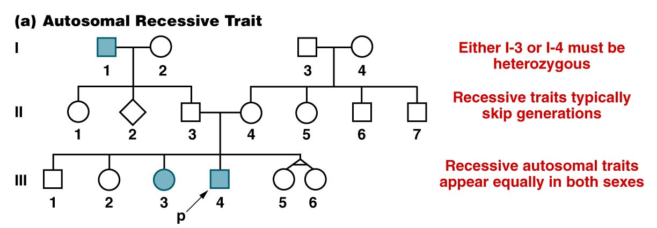
PRACTICE PEDIGREES!!
…but not always!
“ Autosomal” refers to chromosomes which have no role in sex determination. In humans, chromosomes 1-22 are autosomes, X and Y are sex chromosomes.
Figure 3.14a
Notes:
Figure 3-14a A representative pedigree for an autosomal recessive trait followed through three generations.

Slide 17
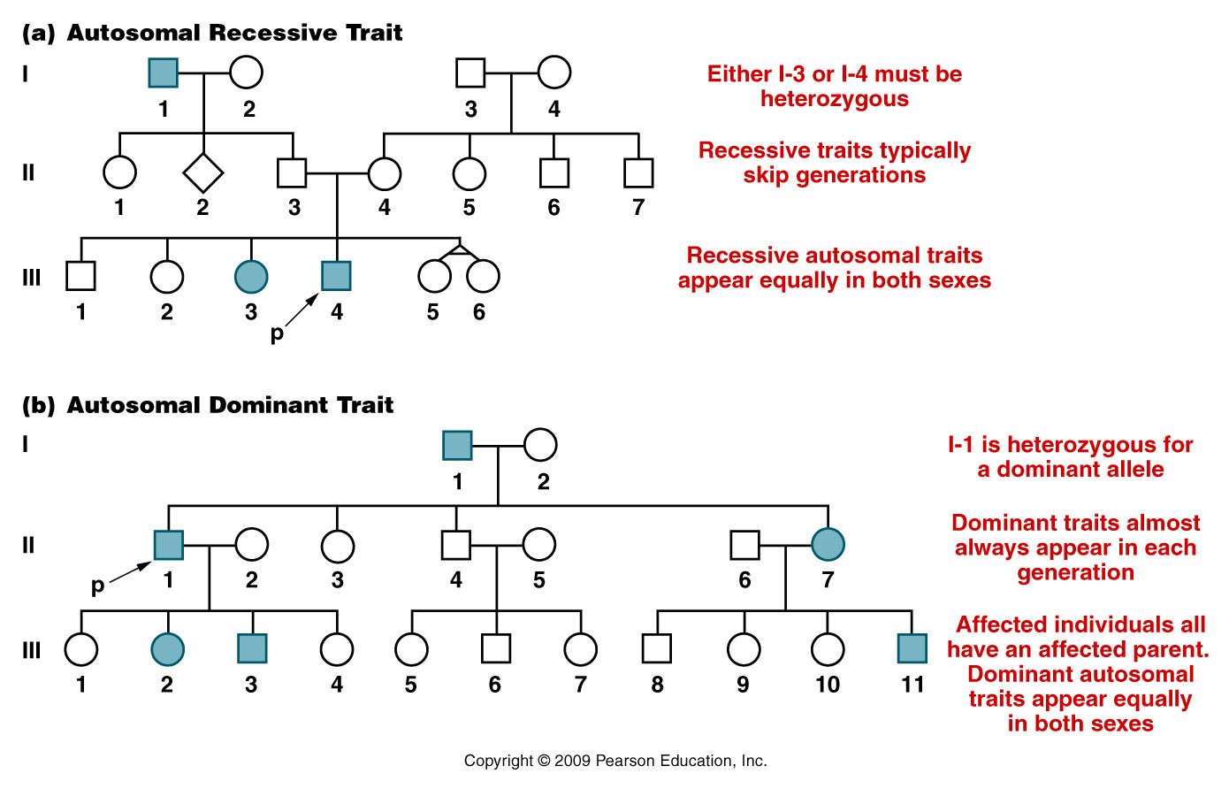
Figure 3.14
Notes:
Figure 3-14 (a) A representative pedigree for an autosomal recessive trait followed through three generations. (b) A representative pedigree for an autosomal dominant trait followed through three generations.

Slide 18
The following are a partial list of genetic human traits which cause problems in basic living---So we call them diseases.
Not all genetic traits are diseases. Not all diseases are genetic.
Your book has a short list in table 3.4

Slide 21
Recessive traits/diseases
Going beyond symbols and names---how generally do we think of a recessive trait?
An individual must inherit 2 recessive alleles to express the trait.
What might the recessive alleles represent?

Slide 22
example…autosomal recessive Albinism

Slide 23
Let’s think about recessive traits…
Albinism AA or Aa genotype---normal pigmentation
aa genotype no skin/hair/eye pigment
Molecular explanation? The “A” gene controls production of skin pigment---melanin.
A allele= normal/wild-type allele
a allele= abnormal/mutant/non-functional allele
A__ normal pigment aa no pigment
(one normal allele is sufficient for normal pigmentation)

Slide 24
Tay-Sachs disease
Another great example of a disease caused by a recessive allele of a gene.
The allele is rare in the population as a whole, but shows how populations which are geographically or culturally isolated can greatly increase the frequency of any allele.
(1/27 Ashkenazi Jews (Jews of central or eastern European descent) is a heterozygous carrier of the Tay Sachs allele.) Among other Jewish groups only 1/250 are carriers.
P.61-62---Read about the molecular explanation for the disease! What gene is involved? HEXA

Slide 25
Read about HEXA gene
http://ghr.nlm.nih.gov/condition/tay-sachs-disease
P. 62 of text
Genetics Home Reference website---put Tay Sachs in the search box.

Slide 26
Lets think about dominant traits…
Huntington disease—
hh-normal
Hh or HH has the neurological disease
The presence of 1 abnormal allele, somehow overrides the function of the normal allele
OR
A single copy of the normal allele is not sufficient for normal neurological function

Slide 27
Huntington Disease…
Great example of a disease caused by a dominant allele of a gene.
Overall, dominant diseases (and the alleles that cause them) are fairly rare in the population.
Why? There are no “unaffected carriers” . Individuals who carry the allele, always show the trait (have the disease) so they may not be able to reproduce or may opt not to.

Slide 28
Huntington Disease…
Particularly tragic because it does not develop until late life---sometimes 40 years of age or older.
Affected individuals may have already had children.
What is the probability that an idividual with Huntington disease will have a child with the disease? (Assume the huntingon alleles is rare).

Slide 29
HTT gene—read about it
http://ghr.nlm.nih.gov/condition/huntington-disease
Genetics Home Reference website---put Huntington disease in the search box.

Slide 30
Always return to molecular explanations for traits.
gene/allele RNA (protein) effect/trait/characteristic
Different alleles give rise to different forms of the same protein---explaining specific traits.

